Slide 1
Lecture 2:
1.1. Theory: Robert Solow’s Economic Growth Model
Brad DeLong
Department of Economics and Blum Center, U.C. Berkeley; WCEG; and NBER
last revised: 2019-10-15
Original course by Melissa Dell (Harvard Econ 1342), revised by Brad DeLong, research assistance by Anish Biligiri
<https://github.com/braddelong/public-files/blob/master/econ-115-lecture-2.pptx>

Slide 2
Solow Model Basics
Lecture Notes: <https://www.bradford-delong.com/2020/01/lecture-notes-the-solow-growth-model-the-history-of-economic-growth-econ-135.html>
Let's assume three things about the relationship between an economy's resources and the total output it produces and income it generates:
Production
Other parts of the model
Balanced-growth equilibrium
Convergence to equilibrium

Slide 3
Solow Model Basics: Production
Let's assume three things about the relationship between an economy's resources and the total output it produces and income it generates:
A proportional increase in the economy's capital intensity κ, measured by the capital stock divided by total production κ = K/Y, will carry with it the same (smaller) proportional increase in income and production Y no matter how rich and productive the economy is. A 1% increase in capital intensity will always increase income and production by the same proportional amount.
If two economies have the same capital intensity, defined as the same capital-output ratio κ, and have the same level of technology- and organization-driven efficiency-of-labor E, then the ratio of their levels of income and output will be equal to the ratio of their labor forces L.
If two economies have the same capital intensity, defined as the same capital-output ratio κ, and have the same labor forces, then the ratio of their levels of income and output will be equal to the ratio of their technology- and organization-driven efficiencies-of-labor E

Slide 4
Basics: Production Notation
Y: total income and production
E: technological and organizational efficiency-of-labor
L: labor force
y: per-worker income and production
κ: the capital-intensity of the economy, as measured by the capital-output ratio K/Y (Greek lower kappa)
θ: the relative salience in economic growth of capital-intensity vis-a-vis technological and organizational progress (Greek lower theta)
if α is the share of income received by capital under the marginal productivity theory of distribution, then α=θ/(1+θ), 1-α=1/(1+θ), θ = α/(1-α)

Slide 5
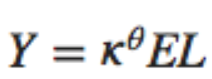
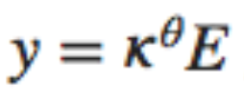
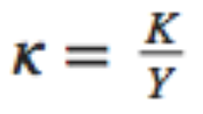
Basics: Production Algebra
Then there is one and only one equation that satisfies those three rules of thumb:
And it is also worth writing down
a version of this equation in per-worker form, where y = Y/L
the definition of capital intensity κ: κ= K/Y
We have just done what economists typically do: take a complex situation, strip things down to some salient piece of it, and then formalize and algebraize that piece in the hope of gaining insight…

Slide 6
Solow Model Basics: Notes
The code in the nbViewer documents is static. But you should also look at:
<http://datahub.berkeley.edu/user-redirect/interact?account=braddelong&repo=long-form-drafts&branch=master&path=solow-model-2-basics.ipynb>
<http://datahub.berkeley.edu/user-redirect/interact?account=braddelong&repo=long-form-drafts&branch=master&path=solow-model-3-growing.ipynb>
<http://datahub.berkeley.edu/user-redirect/interact?account=braddelong&repo=long-form-drafts&branch=master&path=solow-model-4-using.ipynb>

Slide 7
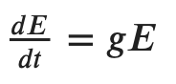
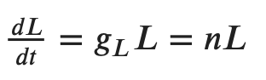
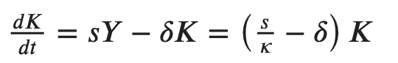
The Rest of the Model: Growth Rates
Variables change over time:
growth of labor gL: proportional at a constant n (for now)
growth of labor efficiency gE: proportional at a constant g (for now)
rate of change of capital: savings minus depreciation
What do these mean?
Now let’s look at the rate of change of capital-intensity κ as a function of the level of capital-intensity κ, for constant n, g, s, δ, and θ…

Slide 8
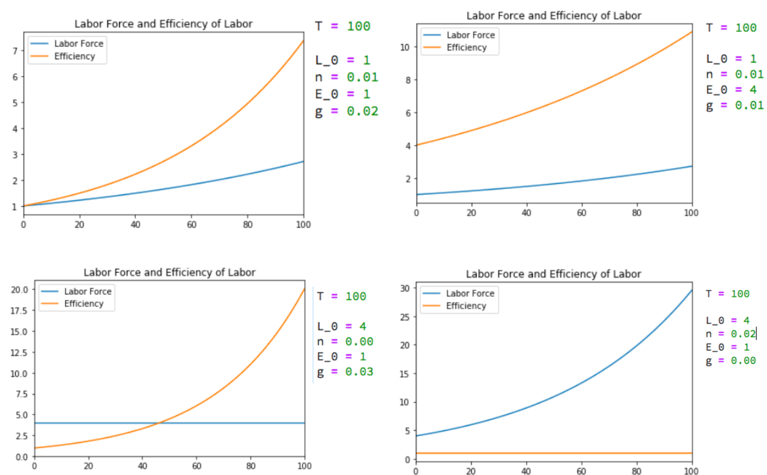
Growth Rates: L & E

Slide 9
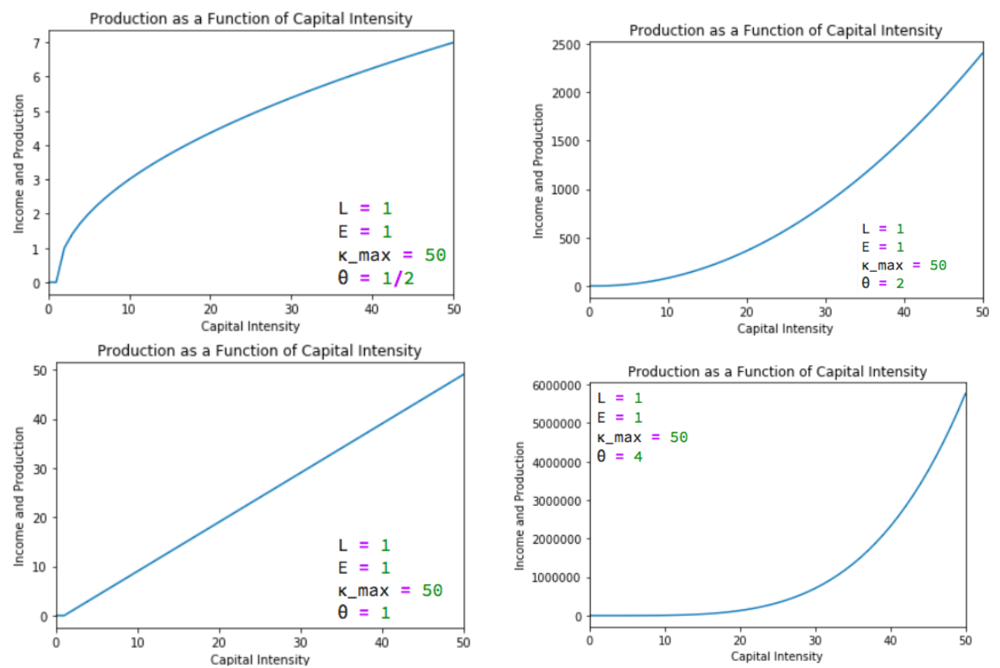
Salience of Capital: θ

Slide 10
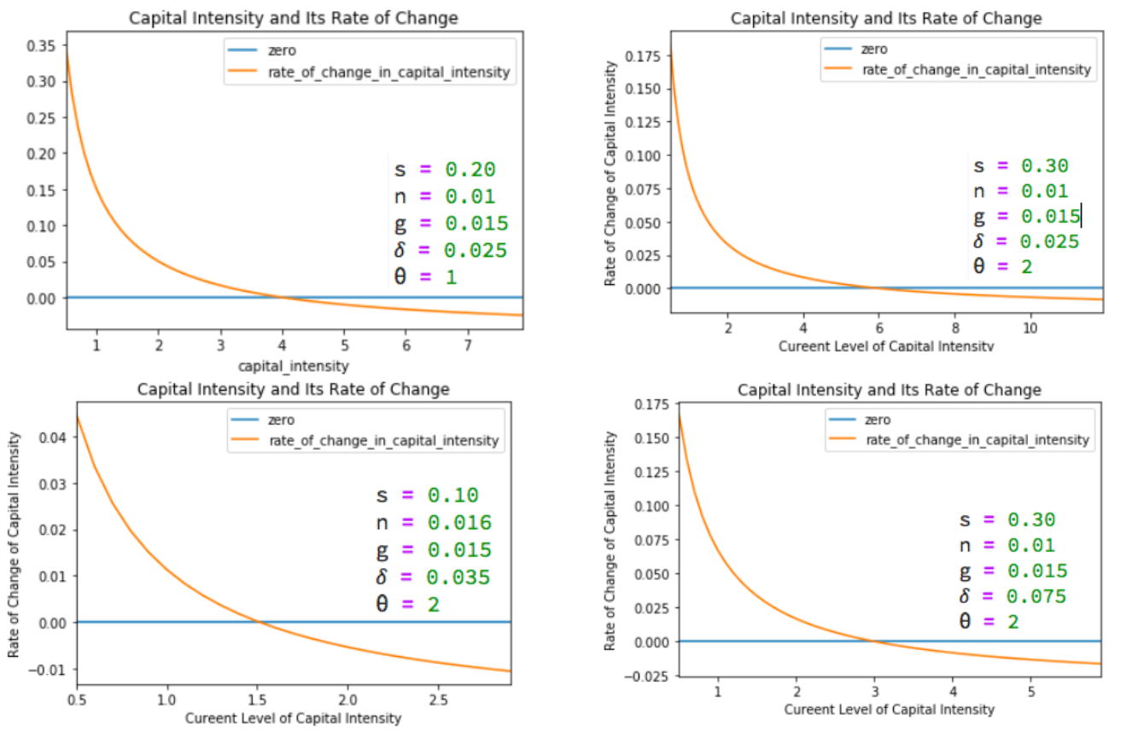
Change in Capital-Intensity κ as a Function of Its Level

Slide 11

Catch Our Breath…
Ask a couple of questions?
Make a couple of comments?
Any more readings to recommend?

Slide 12
THE RULE OF 25!
You are going to be nodding off by now—if you haven’t already…
So stand up…
Introduce yourself to your neighbors to left & right…
& say something nice…
& now we will do some review: <https://www.icloud.com/keynote/0SdT7FNHq2y3FcaD2KU9zRrxg>

Slide 13
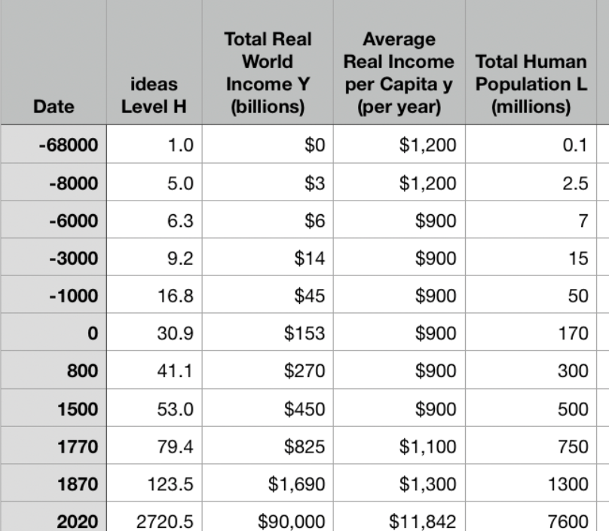
Changeup Review: One Table: Average Global Numbers
J. Bradford DeLong brad.delong@gmail.com 2020-01-18 <https://www.icloud.com/keynote/0SdT7FNHq2y3FcaD2KU9zRrxg>

Slide 14
You’ve Seen This Before…
Approximately what was the growth rate of the human useful-ideas stock between the year 0 and 1500?
About 0.036%/year
About 3.6%/year
About 2.06%/year
About 0.206%/year
None of the above are close

Slide 15
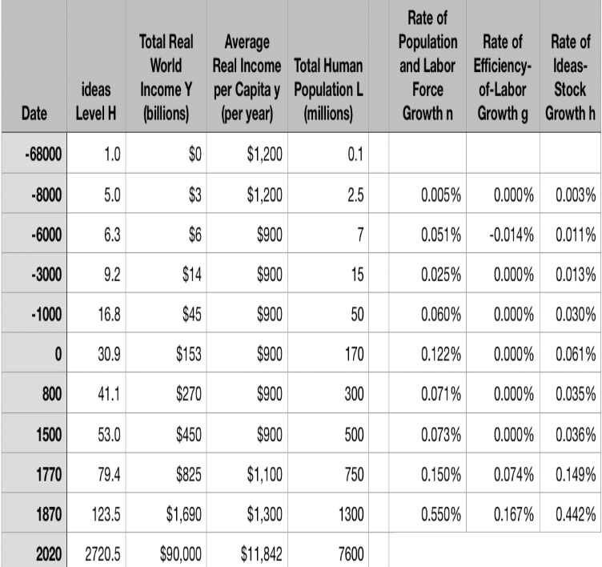
One Table: Average Global Numbers
Approximately what has been the growth rate of the human useful-ideas stock between the year 1870 and today?
About 0.036%/year
About 3.6%/year
About 2.06%/year
About 0.206%/year
None of the above are close

Slide 16

Why Is This Interesting?
2.06/.0036 is about 60, no?
What else do you find interesting about this table to the left?

Slide 17
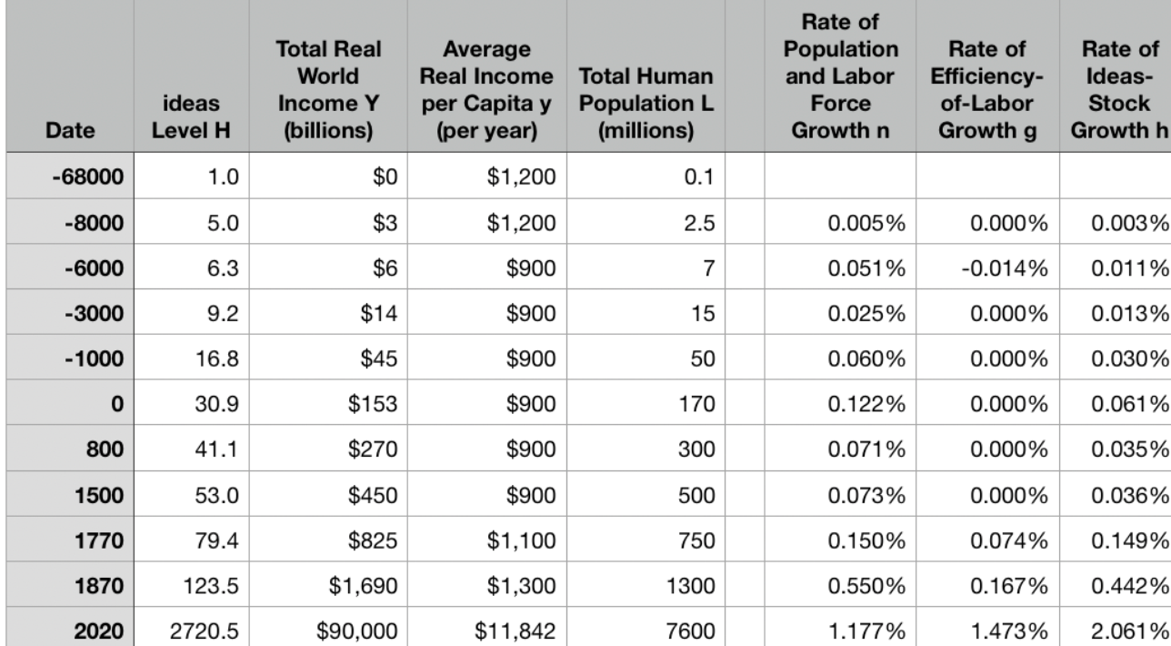
One Table: Average Global Numbers
10:00

Slide 18
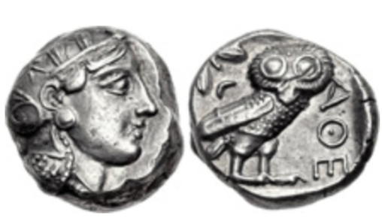
Questions
What assumption that Aristotle made—perhaps (probably?) without thinking about it, because it seemed most obvious to him—struck you as the most wrong or repugnant or weird?
What role do the “statues of Daedalus, [and] the tripods [robotic catering vessels] of Hephaestus” play in Aristotle’s argument about how the economy of his age is, must be, and should be structured?
What role does Aristotle’s claim that “Of the art of acquisition [ktêtike] then there is one kind which by nature is a part of the management of a household…. There is another… commonly and rightly called an art of wealth-getting [chrêmatistikê]… [with] the notion that riches and property have no limit…” play in his argument?
Did you find any advice—even indirect and oblique advice—from Aristotle in this passage about what the economic policy of a city-state should be? If so, what was it? If not, why do you think he fails to offer advice here (he offers lots of advice as to the organization and policies of city-states later on in the book)?
What does Aristotle say are the four tasks of the Greek man in managing his household? Why these four?
What are these four in rank order of importance
Classical Athenian 4-drachma silver coin
The “owl”, with the head of the goddess Athene on the front and her familiar bird of wisdom on the back, of the type that Aristotle (or his slaves) would have carried on their person. Weighs 3/5 of an ounce. The Athenian navy paid its oarsmen one drachma a day.
J. Bradford DeLong brad.delong@gmail.com 2020-01-06

Slide 19
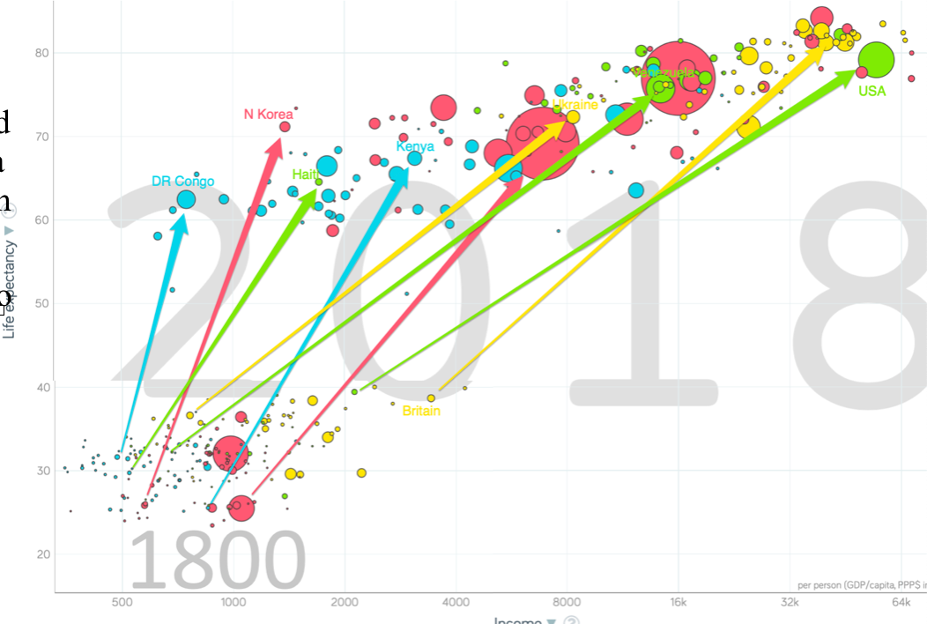
One Figure: A Great Divergence
10:20
From 1800 to 2018:
The dots start with a 3-1 spread in incomes and a 10-year spread in life expectancy.
All the arrows go up.
Some arrows—mostly those already to the right—go right fast.
Other arrows go right slowly.

Slide 20
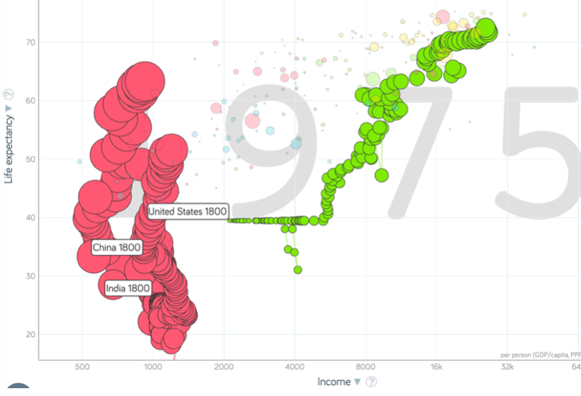
China and India and America, 1800-1975
From 1800 to 1975:
Measured living standards and productivity levels improve fourteen-fold in the United States…
…& less than 30% in China & India…
…in spite of economic, transport, and cultural globalization…
This is crazy!
A “great divergence”
Not only were China & India relatively poor in 1800, they fell further behind thereafter

Slide 21
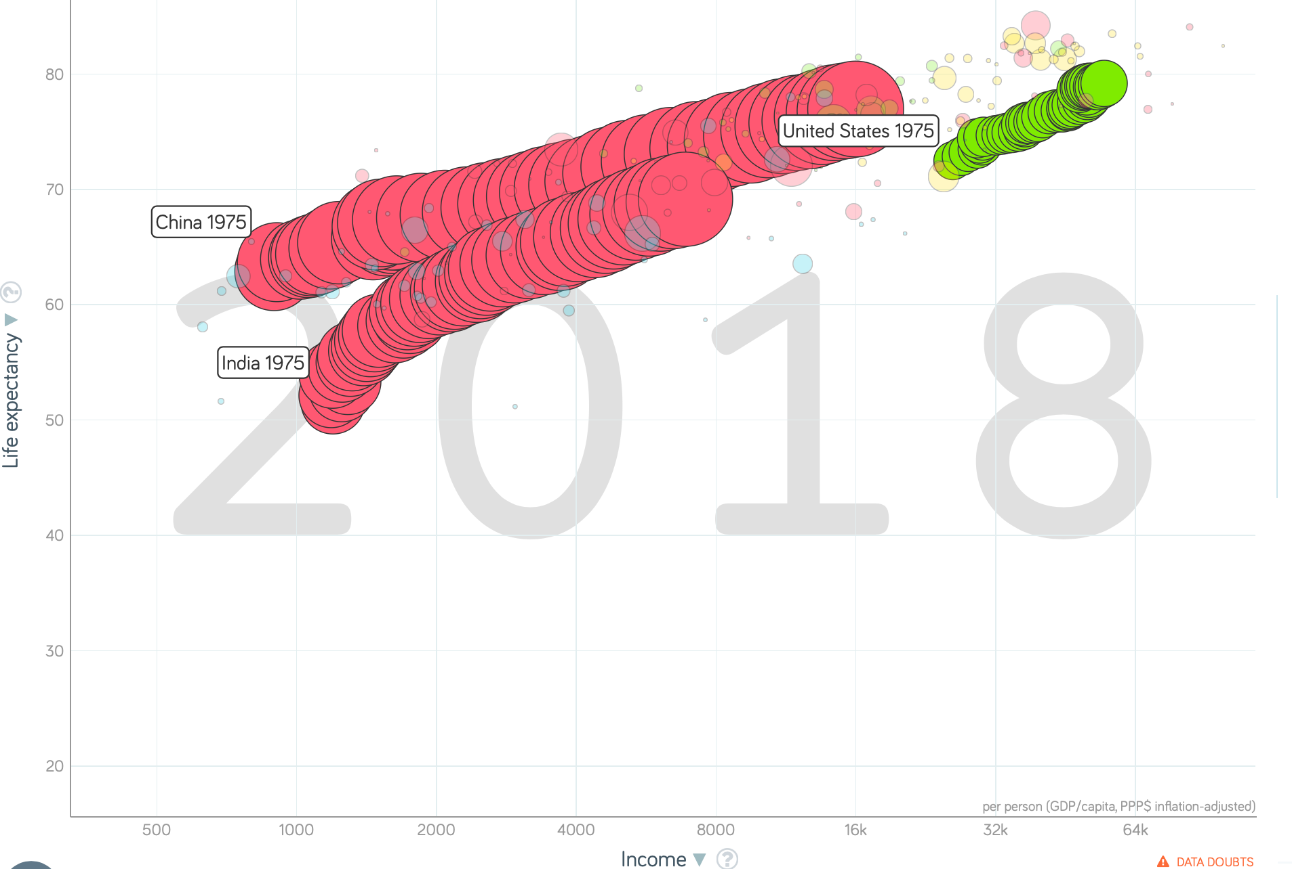
China and India and America, 1975–2018
From 1975-2018:
Measured living standards and productivity levels…
…54.9/25.9 = 2.12 in America…
…16.0/0.9 = 17.8 in China…
…6.9/1.2 = 5.8 in India…

Slide 22
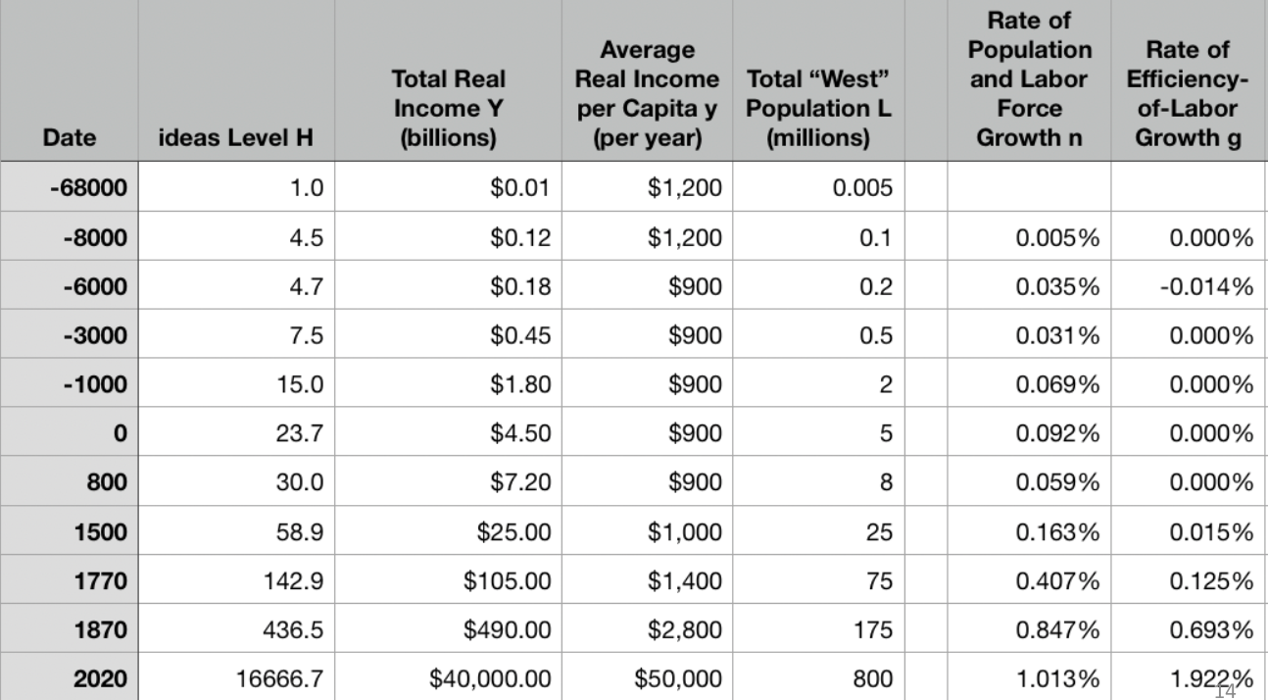
A Second Table: “The West”
10:45

Slide 23
Four Major Features
10:55
The history of economic growth has four major features:
Poverty, in the pre-industrial ages, with population growth on average but with average population growth very slow
n = 0.07%/yr; h = 0.035%/yr
Growing prosperity, in the Industrial Revolution and the Modern Economic Growth ages
In the MEG era: h = 2.06%/yr
The great divergence
Globalization
American twentieth-century economic ascendancy
Pre-industrial efflorescences and declines

Slide 24

Catch Our Breath…
Ask a couple of questions?
Make a couple of comments?
Any more readings to recommend?

Slide 25
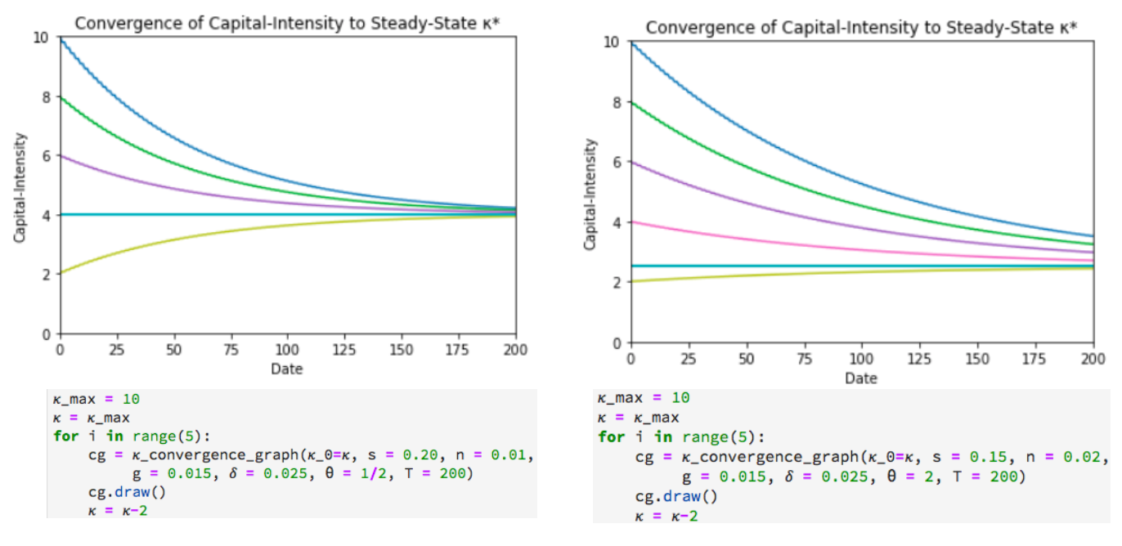
Solving the Model

Slide 26
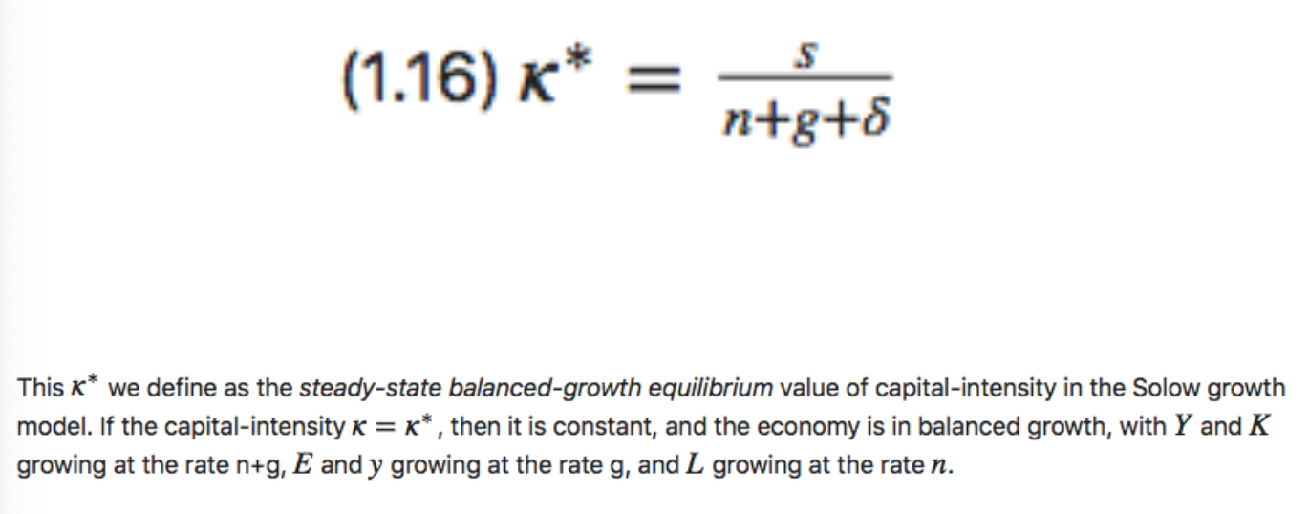
Balanced-Growth Equilibrium: Steady-State Capital-Intensity κ*

Slide 27
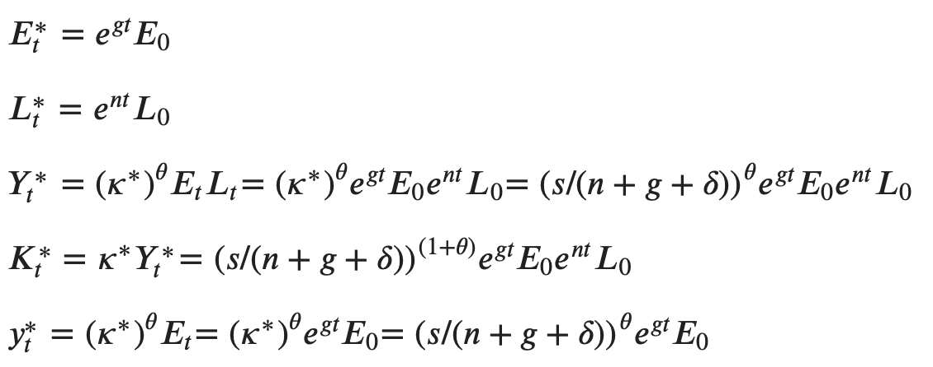
Along the Balanced-Growth Path
Everything except κ—which is constant—grows at a constant proportional rate: either n, or g, or n+g;
Labor force L grows at n
Income per worker y and the efficiency of labor E grow at g
Total income Y and the capital stock K grow at n+g

Slide 28
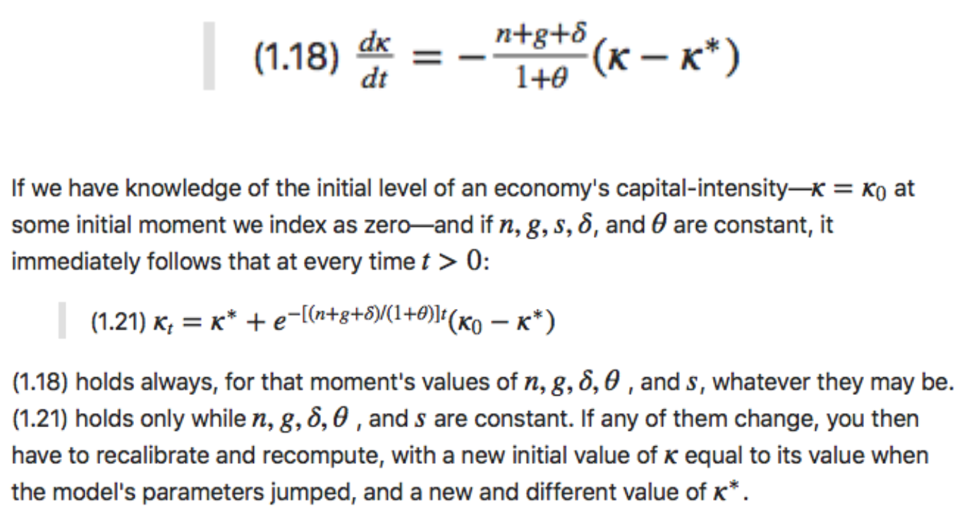
Convergence to Steady-State Capital-Intensity

Slide 29
Convergence to κ*

Slide 30
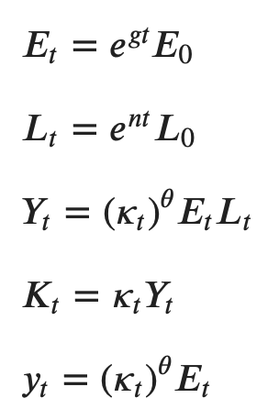
Other Variables in the Model

Slide 31
Catch Our Breath…
Ask a couple of questions?
Make a couple of comments?
Any more readings to recommend?

Slide 32
Basic References
Robert Solow (1956): A Contribution to the Theory of Economic Growth <http://piketty.pse.ens.fr/files/Solow1956.pdf>
Moses Abramovitz (1956): Resource and Output Trends in the United States Since 1870 <https://www.nber.org/chapters/c5650.pdf>
Robert Solow (1957): Technical Change and the Aggregate Production Function <http://www.piketty.pse.ens.fr/files/Solow1957.pdf>
Moses Abramovitz (1956): Catching Up, Forging Ahead, and Falling Behind <http://www.j-bradford-delong.net/teaching_Folder/Econ_210c_spring_2002/Readings/Abramovitz.pdf>
Robert Solow (1987): Growth Theory and After <https://www.nobelprize.org/prizes/economic-sciences/1987/solow/lecture/>

